Slide 1
GA Final project pubg
Lucas Koo
13 April 2019

Slide 2
In the game, up to one hundred players parachute onto an island and scavenge for weapons and equipment to kill others while avoiding getting killed themselves... The last player or team standing wins the round.

Slide 3
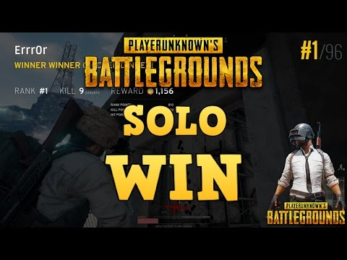
objective

Slide 4
DATA source
kaggle
place to do data science projects
OP.GG
provides insights to gamers

Slide 5
Cleaning the data
Remove
Match ID
Player Name
Filter
Match Type
Party Size
Outlier
Survived Time
Game Size

Slide 6
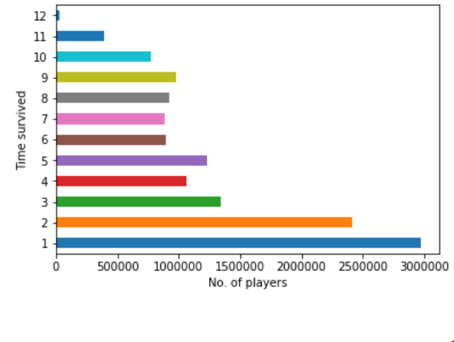
how long can one survive?

Slide 7
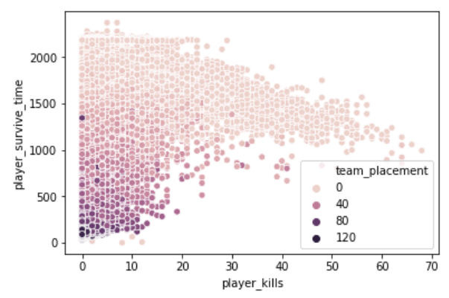
Does killing win the game?

Slide 8
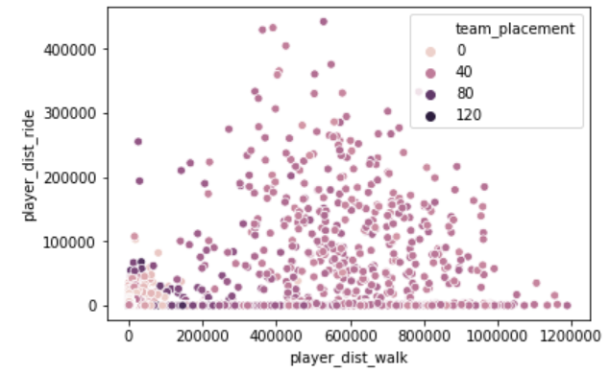
Travel or camp?

Slide 9
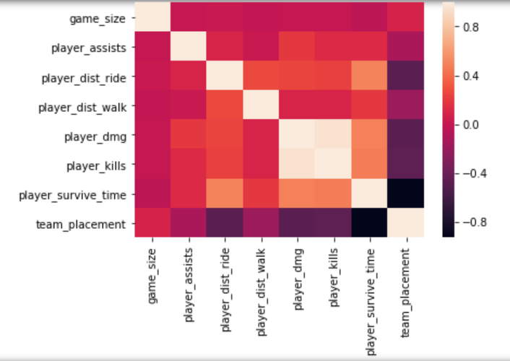
Correlation

Slide 10
Features and target
Rank
Assists
Walk distance
Damage
Ride distance

Slide 11
Train & TEST DATASET
0.86468
score
Train – 70%
Test – 30%
86.47%

Slide 12
Cross validation
CV = 8
Mean score = 86.47%
Best score = 86.50%

Slide 13
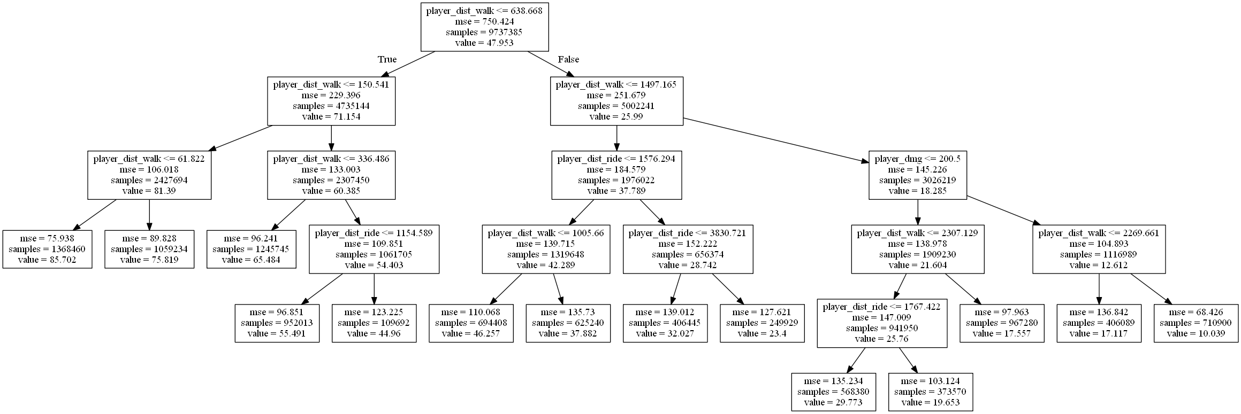
Decision tree

Slide 14
limitation
Location
Armor
Difficulty
Weapon

Slide 15
credits
https://www.kaggle.com/skihikingkevin/pubg-match-deaths
op.gg
https://en.wikipedia.org/wiki/PlayerUnknown%27s_Battlegrounds

